Slide 1


Slide 2
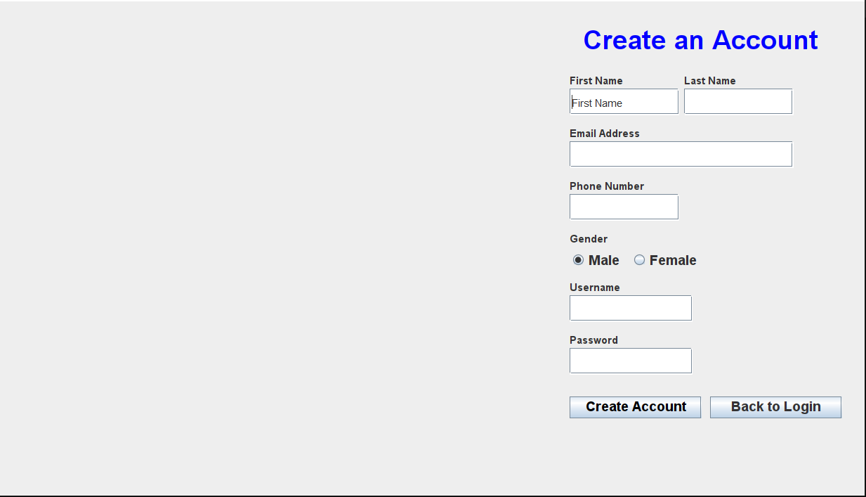
Forget gui

Slide 3

Enter your Username
Get OTP

Slide 4

Enter Authentication Code
Submit

Slide 5
Enter New Password
Change Password

Slide 6
Total Books
Total Orders
Total Customer
Total Employee
10
20
30
40
Add Employee
Order No | Customer Name | Book Name | Order Price | Order Date
1 | Ekramul Haque | Sdfasdfdsf | 332 | 12-12-2022
2 | Mahin Montasir | Dsfsfsdfsg | 564 | 12-12-2022
3 | Arefin | Fgsdfgsfdgfdg | 545 | 12-12-2022
4 | Tonmoy | Fgsfdgsdfgsd | 697 | 12-12-2022
5 | Turjo | Dfgsdfgsdfg | 989 | 12-12-2022
6 | Anjir Ahmed | Dfgsdfgsfdg | 985 | 12-12-2022
7 | Void Mia | fgsffsdgdsfg | 569 | 12-12-2022

Slide 7

Employee Name
Employee ID
Employee Password
Add Employee

Slide 8
Total Books
Total Orders
Total Customer
10
20
30
Add Books
Books Name | Books Category | Book Price
1
2
3
4
5
6
7

Slide 9
Book name
Author name
Category
Book Price
Image Path
Add Book

Slide 10


HOME
BOOKS
ACCOUNT
CONTACT US
Banner

Slide 11


Slide 12
HOME
BOOKS
ACCOUNT
CONTACT US
Category
All Books
Islamic Books
Others

Slide 13
HOME
BOOKS
ACCOUNT
CONTACT US
Category
All Books
Islamic Books
Others

Slide 14
HOME
BOOKS
ACCOUNT
CONTACT US
Category
All Books
Islamic Books
Others

Slide 15

HOME
BOOKS
ACCOUNT
CONTACT US
Balance: 500.00
Add Balance
Username : Mahinafif
Name: Mahin Montasir Afif
Email:mahin.afif360@gmail.com
Gender : Male
Number : 01721546987
Change password

Slide 16
Enter Current Password
Enter New Password
Change Password

Slide 17

HOME
BOOKS
ACCOUNT
CONTACT US
Helpline
Phone number : 01225846873
Email address : marhin.afif360@gmail.com
Facebook page : www.facebook.com/voidBookShop
About us
Chaldal.com is an online shop available in Dhaka, Chattogram, Jashore, Khulna, Sylhet, Gazipur, Rajshahi and Narayanganj. We believe time is valuable to our fellow residents, and that they should not have to waste hours in traffic, brave bad weather and wait in line just to buy basic necessities like eggs! This is why Chaldal delivers everything you need right at your door-step and at no additional cost.

